Slide 1
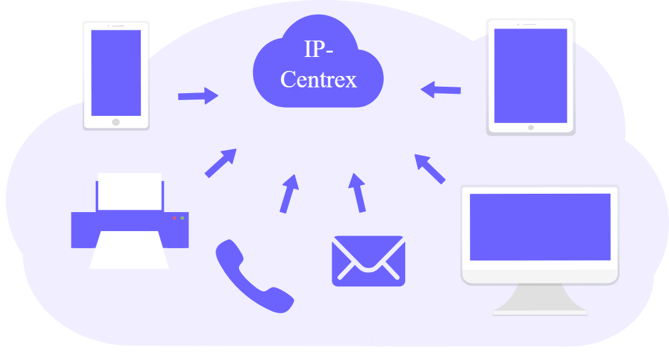
Reliance Jio IP Centrex Call: 9113098853
(IP based Cloud PBX service)

Slide 2
Reliance Jio Infocomm IP Centrex (IP based Cloud PBX service) Provider in India – Bangalore, Chennai for Price/Cost Call: 9113098553
IP Centrex is a cloud-based telecommunications solution that delivers the functionality of a traditional PBX (Private Branch Exchange) system over the Internet. It is part of the broader category of hosted voice services, leveraging VoIP (Voice over Internet Protocol) technology. Instead of maintaining physical PBX hardware on-site, businesses use a centralized system hosted by a service provider.

Slide 3
Reliance Jio IP Centrex
Key Features
Cloud-Based Management:
  All PBX functionalities are hosted and managed by the service provider.
Unified Communication:
  Integration of voice, video, messaging, and conferencing services.
Scalability:
  Easily add or remove users without requiring additional hardware.
Cost-Effective:
  No need for upfront investment in PBX equipment; charges are typically based on a subscription model.
Feature-Rich:
  Offers advanced features like auto-attendant, call recording, IVR (Interactive Voice Response), and voicemail-to-email.
Geographic Independence:
  Employees can access the service from anywhere with an internet connection.

Slide 4

Reliance Jio IP Centrex

Slide 5

9113098553

Slide 6


